Slide 1
Myths about .Net

Slide 2



What is Myths?

Slide 3




Myths in real life

Slide 4
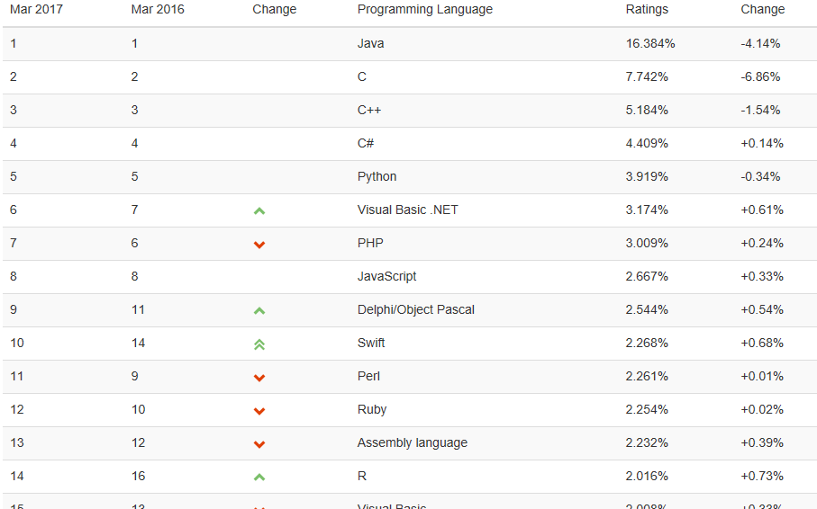
Myths in IT
TIOBE Index
https://www.tiobe.com/tiobe-index/

Slide 5
Myths in .Net
.Net – it’s only Windows and enterprise
.Net – it’s very expensive!
Only paid books and courses
Microsoft make nothing for Education and Science
Microsoft don’t like Open Source and standards

Slide 6
.Net – its: language / library / interpreter…
0

Slide 7
.NET Framework - is a software framework developed by Microsoft. It includes
a large class library named Framework Class Library (FCL)
language interoperability across several programming languages.
Programs written for .NET Framework execute in Common Language Runtime (CLR), an application virtual machine that provides:
security,
memory management,
and exception handling.
As such, computer code written using .NET Framework is called "managed code".
Wikipedia
ASP.Net
ASP.Net MVC
WPF / Win Forms
WCF
Workflow
LINQ
Entity Framework
TPL
…
C#
VB.Net
F#
….
Base Class Library (Threading, XML, ADO.Net, Security, …)
Common Language specification
Common Language Runtime (CLR)
Notes:
.NET Framework (pronounced dot net) is a software framework developed by Microsoft that runs primarily on Microsoft Windows. It includes a large class library named Framework Class Library (FCL) and provides language interoperability (each language can use code written in other languages) across several programming languages. Programs written for .NET Framework execute in a software environment (in contrast to a hardware environment) named Common Language Runtime (CLR), an application virtual machine that provides services such as security, memory management, and exception handling. (As such, computer code written using .NET Framework is called "managed code".) FCL and CLR together constitute .NET Framework.

Slide 8
What is CLR and Managed code?
C++
C#
VB.Net
Developer’s
computer
Compiler
Compiler
Compiler
IL
code
IL
code
Code verification / security
Compilation for target platform
Automatic memory management
Common
language runtime
Just-In-Time Compiler
000101001010101011101110011011111
User’s
computer
000101001010101011101110011011000
Operation system / Hardware

Slide 9
.Net languages
Boo
F#
VB.Net
C#
IronRuby
Managed C++
(C++/CLI)
Nemerle
IronPython

Slide 10
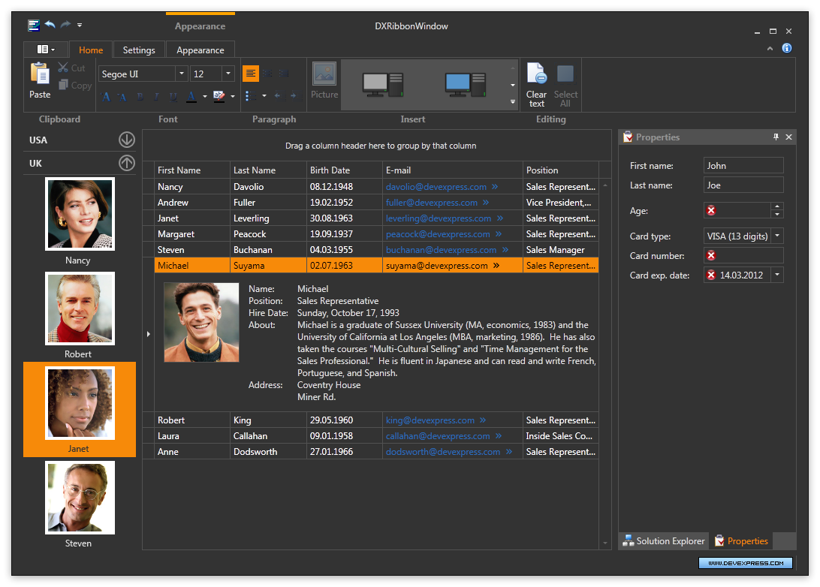
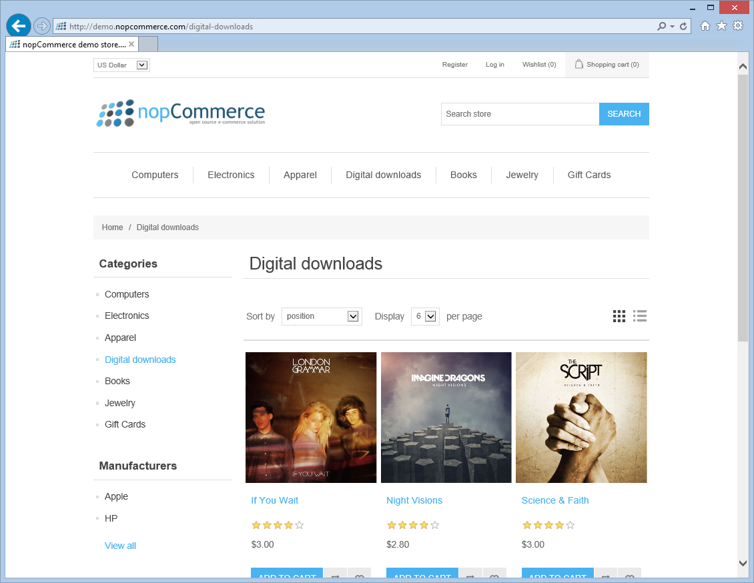
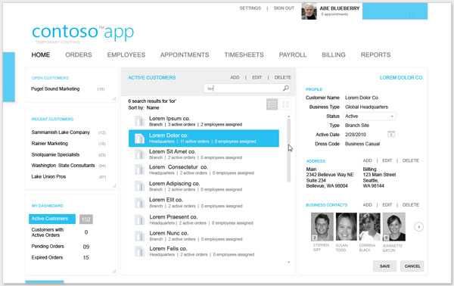
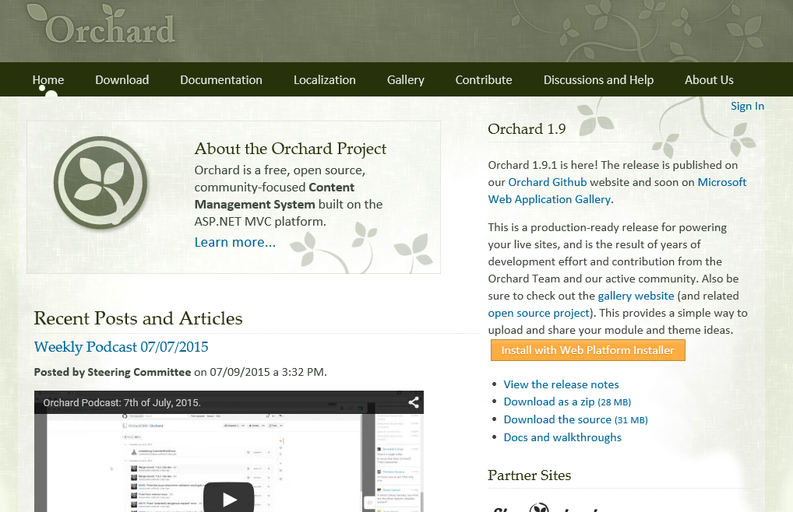
Framework Class Library (FCL)
WPF
ASP.Net
…
Base Class Library
Data Base
Threading
Security
Strings
XML
Date/Time
Network
HTTP

Slide 11
.Net – it’s only Windows and enterprise
1

Slide 12




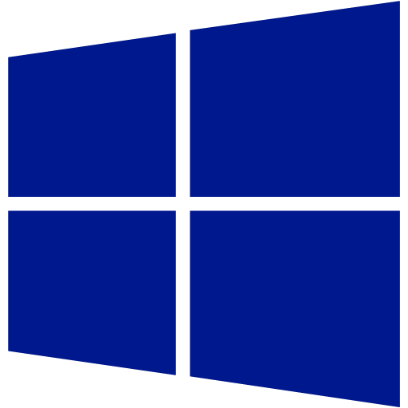





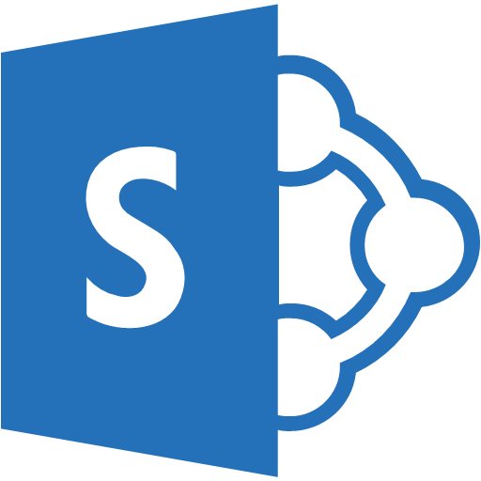



Linux/osX
Mobile
Web
Windows
Cloud
Other
products
Games
IoT
Embedded/
Microprocessors

Slide 13
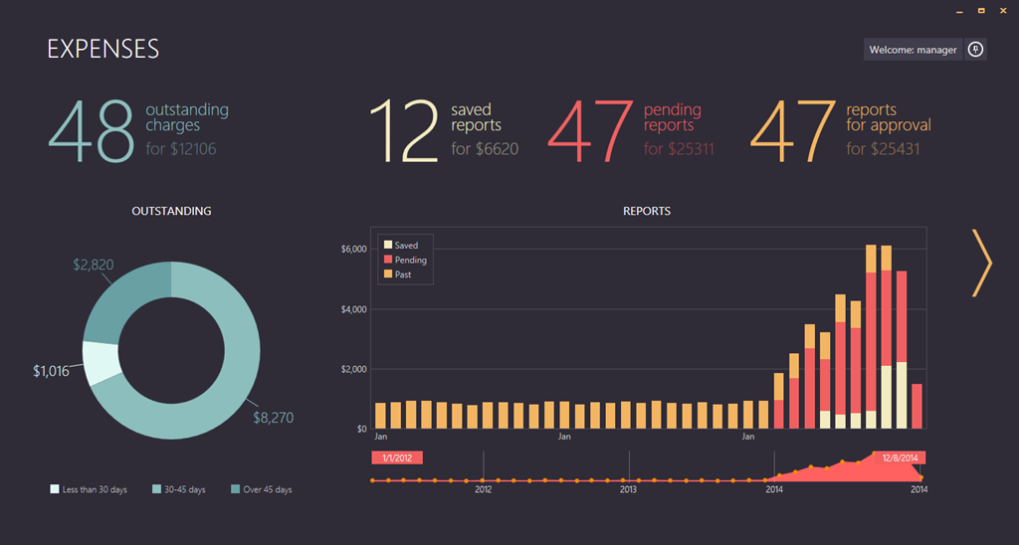
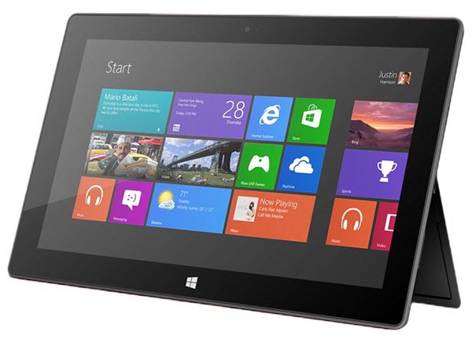
Windows (desktop)
WPF
UWP

Slide 14



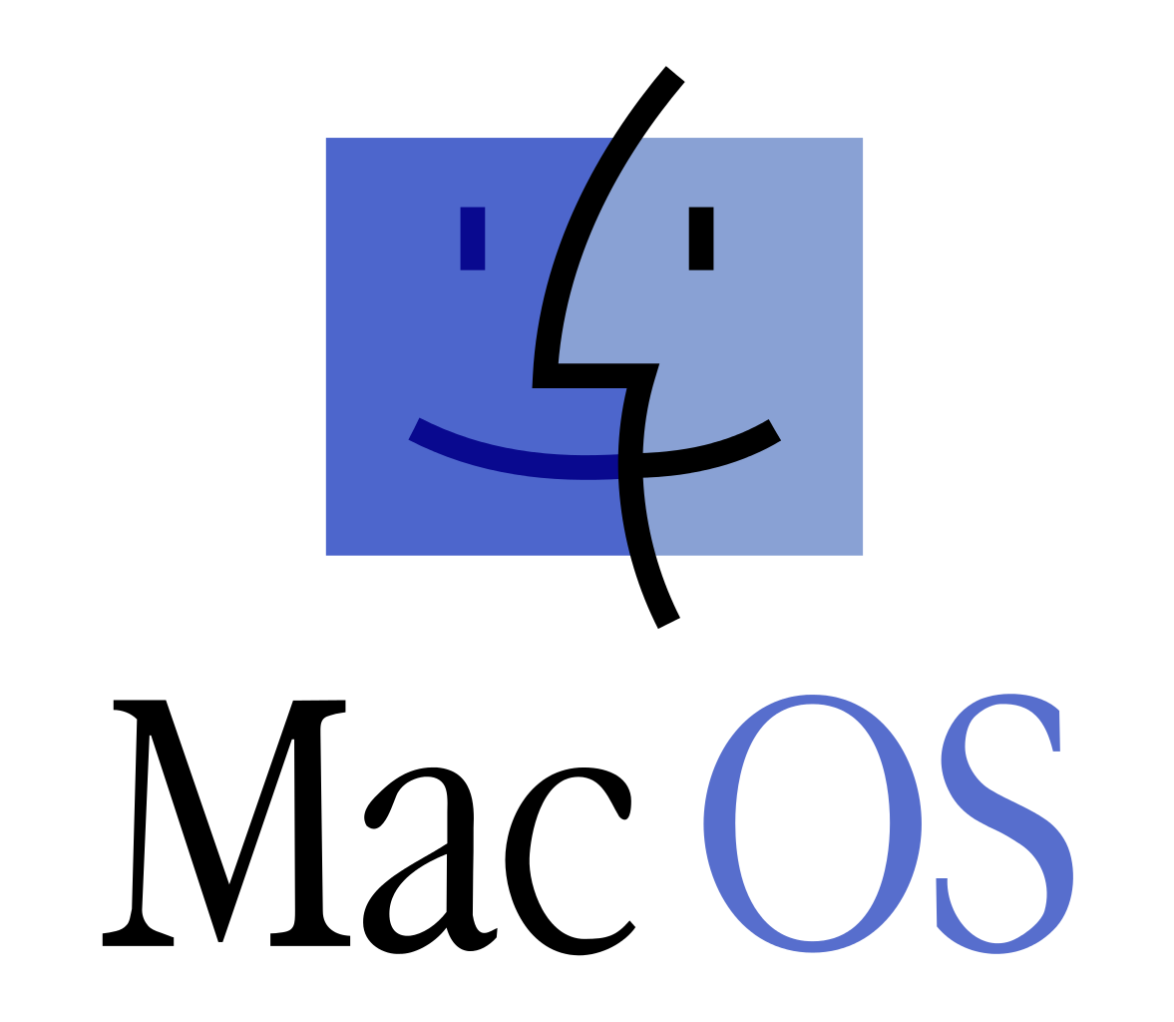
Linux/FreeBSD/osX
.NET Core

Slide 15
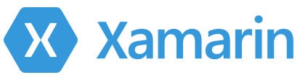

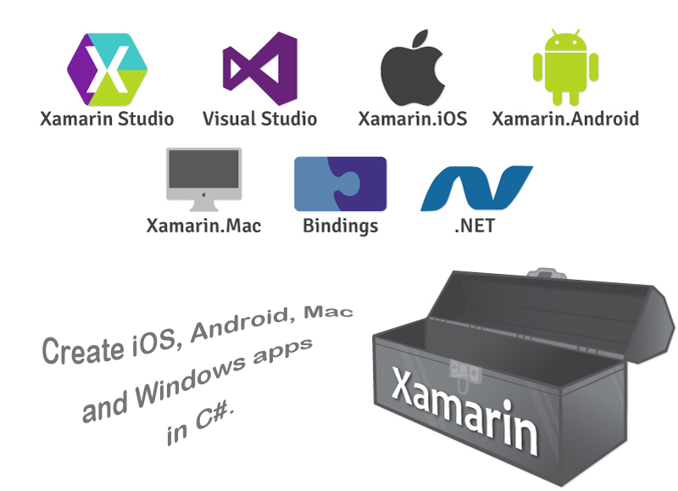
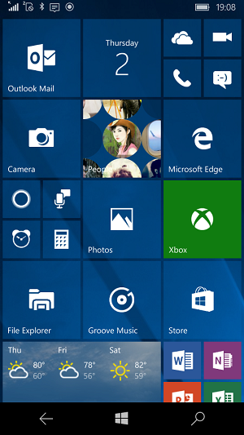
Mobile

Slide 16





Web
Hosting
Frontend
https://hosting.asp.net
More 300 providers
From $1.00 USD/Month
ASP.Net MVC
Web API
In Russia:
https://fozzy.com
http://www.1gb.ru/
https://masterhost.ru/
…
Backend

Slide 17
























Cloud: Azure / AWS
Cloud computing is a type of Internet-based computing that provides shared computer processing resources and data to computers and other devices on demand.
Wikipedia

Slide 18

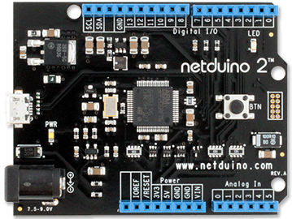
Embedded / Microprocessors
Very small .Net Framework:
Work on a microcontrollers
No OS
Direct access to I/O ports
C#/VB.Net, small FCL subset
Visual Studio support (build, deploy, debug)
Open Source / Free
http://netmf.codeplex.com/
STMicro 32-bit microcontroller
120MHz, Cortex-M3
Code Storage: 192 KB
RAM: 60 KB

Slide 19
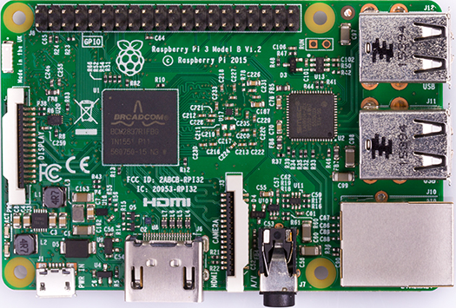

IoT
Windows 10 IoT Core
Raspberry Pi 3

Slide 20

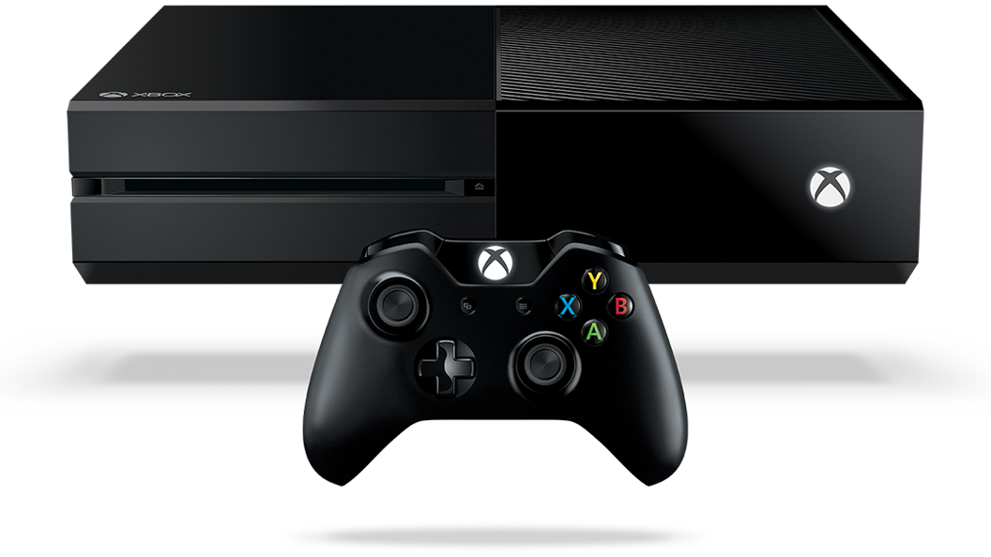


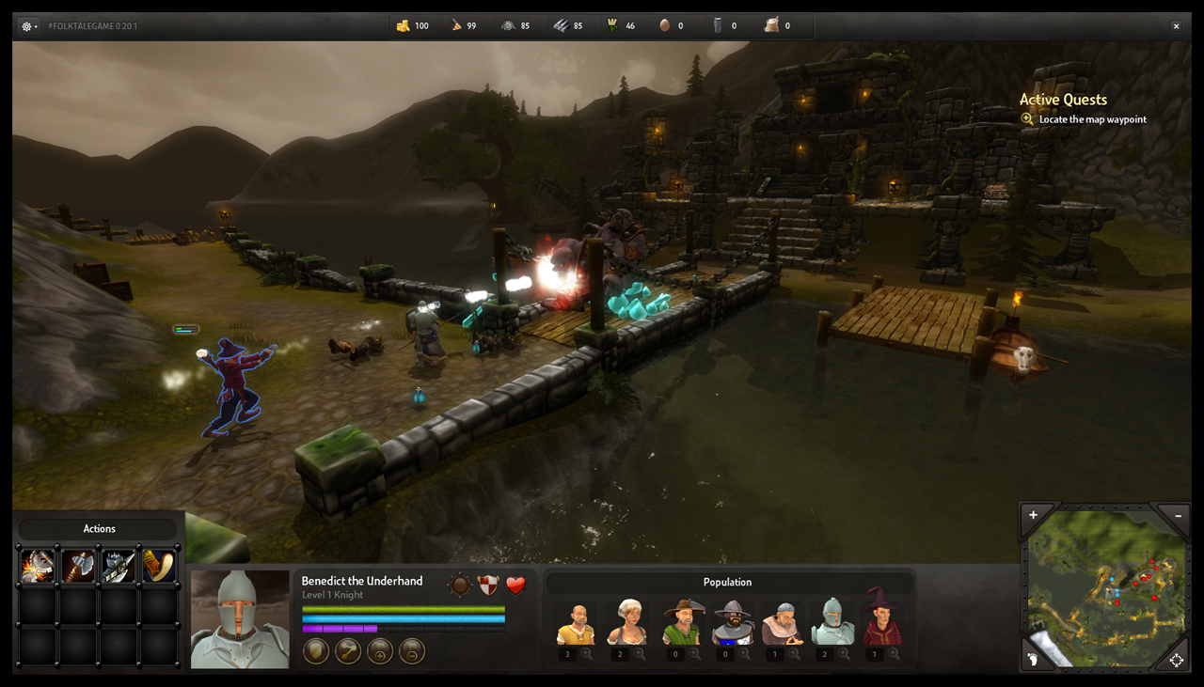
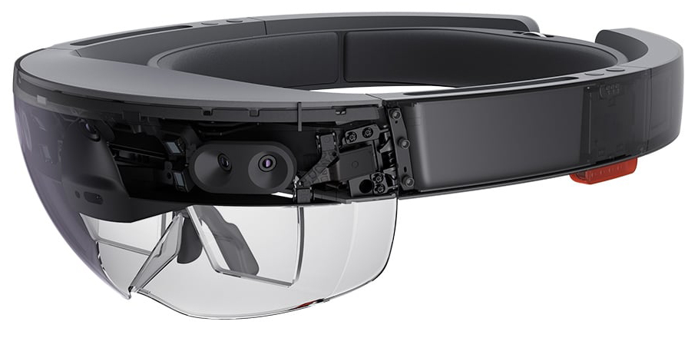
Entertainment / Games

Slide 21
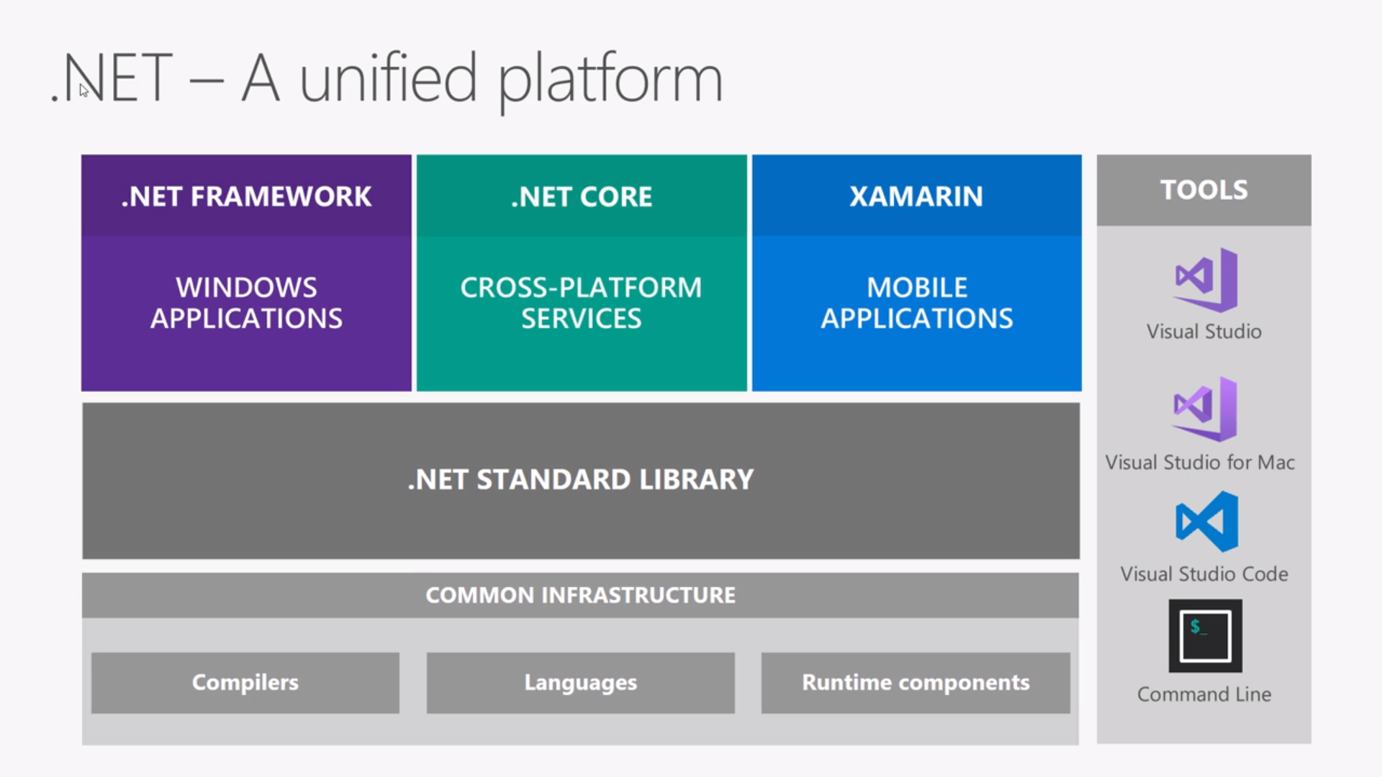

Slide 22
.Net – it’s very expensive!
2

Slide 23

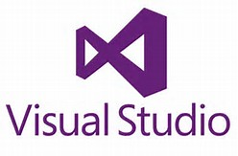

It’s Free???
.Net
.Net Framework
.Net Core
IDE
Visual Studio 2015+ Community
Visual Studio Code
Xamarin Studio
Data Base
SQL Developer 2014+
SQL Express
Mobile
Xamarin

Slide 24
Only paid books and courses
3

Slide 25







eBooks
Free from Microsoft Press
https://mva.microsoft.com/ebooks
Free from Red Get
https://www.red-gate.com/community/books/
Special offers
From 30% to 50 % discount

Slide 26





Learning Resources
RU
RU
http://www.intuit.ru
https://www.techdays.ru/
EN,RU
EN
https://mva.microsoft.com
https://msdn.microsoft.com/
https://msdn.microsoft.com/library
EN
https://msdn.microsoft.com/magazine/
https://channel9.msdn.com/
Notes:
Дмитрий Сошников
Разработка современных приложений на C#
Увлекательное введение в функциональное программирование на F#

Slide 27
Microsoft make nothing for Education and Science
4

Slide 28



For Students
https://www.microsoftimagine.ru/
IzHard
https://imagine.microsoft.com

Slide 29


For Scientists / researchers
https://research.microsoft.com

Slide 30
Microsoft don’t like Open Source and standards
5

Slide 31
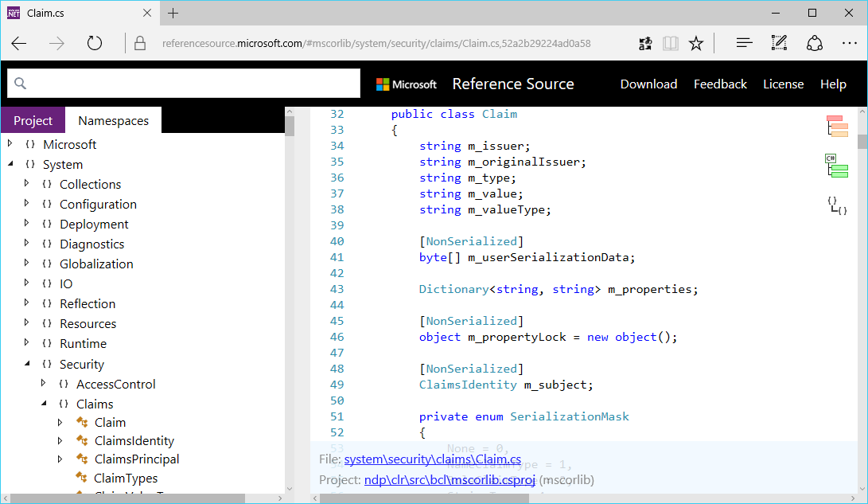
Open source: .Net
.NET – is Open Source
https://referencesource.microsoft.com/
.NET Core
https://github.com/microsoft/dotnet

Slide 32


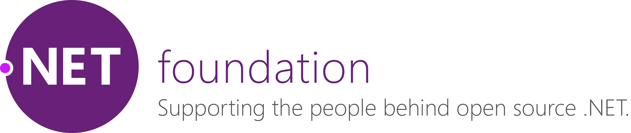
Open Source: organizations
Platinum Sponsor
Platinum Member
Owner

Slide 33
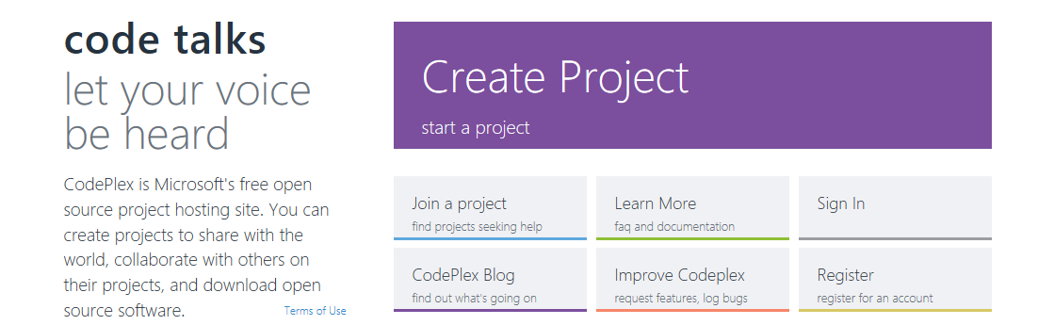
Open Source
More 200 projects on GitHub
Microsoft Cognitive Toolkit
Visual Studio Code
TypeScript
https://opensource.microsoft.com/
Own OpenSource hosting
http://www.codeplex.com/

Slide 34

Demo sources
https://github.com/AlexanderSokolov1/Todo

